Slide 1

DriverPass System Analysis
Matt Knutson

Slide 2

System Requirements
Functional Requirements
The system must verify users when they login.
The system requires administrative access to block an account.
Non-Functional Requirements
DriverPass will have a webpage and mobile application.
DriverPass will use an E-commerce platform.
Notes:
For the DriverPass system to properly secure customer and employee data, the system is required to verify users using their personal passwords. Additional requirements are needed for administrative privileges within the system. Administrative privileges will be needed to block, or reactivate, a customers account. The DriverPass system will also be available as a webpage and a mobile application. This will allow customers to access their accounts from a multitude of different devices and locations. Customers will have a choice between several options of driving packages, which will have different prices based on the customers needs. DriverPass will use an online E-commerce platform to securely and efficiently handle these online transactions.

Slide 3
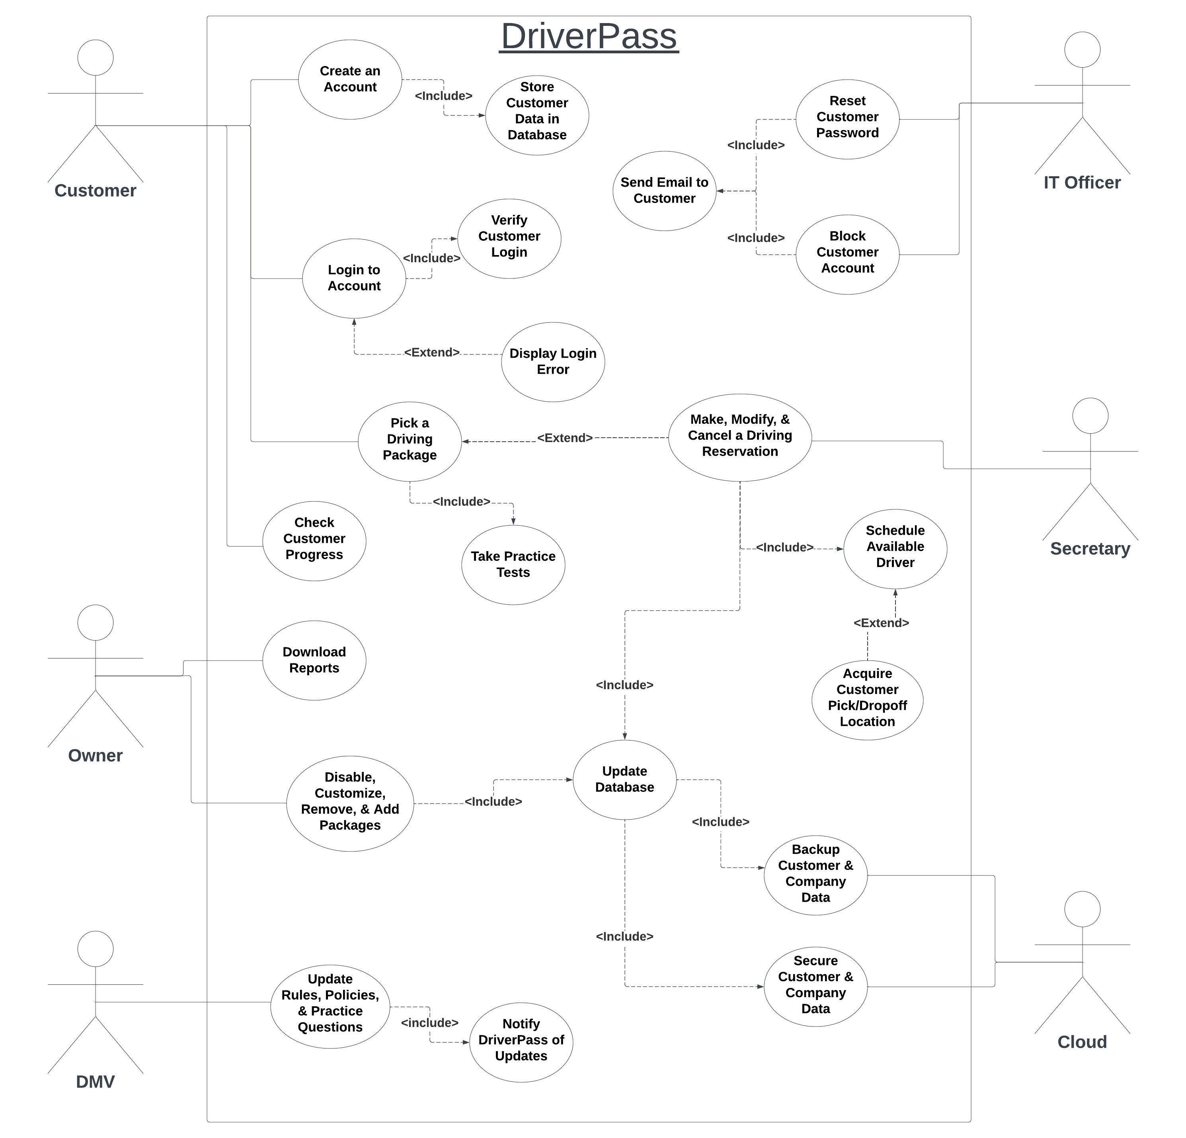
Use Case Diagram
Notes:
This diagram shows the different users of the DriverPass system and the actions that each user will be able to preform. For example, a customer will be able to create a new account, login, pick driving packages, take practice tests , and so on. The lines that connect the objects represent a relationship between them. As shown in the diagram, many users will be able to perform the same actions as each other.

Slide 4
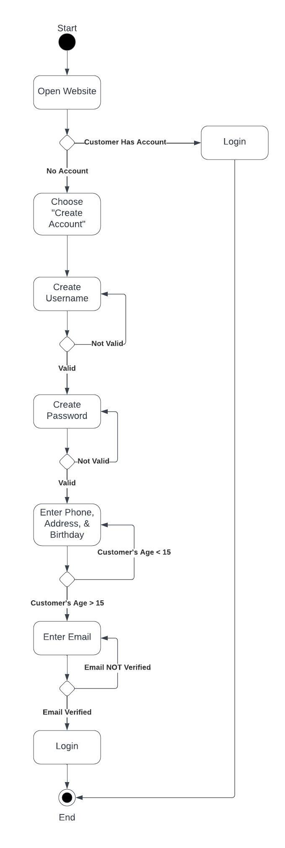
Activity Diagram
Notes:
This activity diagram shows the process of a customer making a new account. The interaction starts at the top and works its way down towards the target at the bottom of the diagram. The direction that each arrow points shows the flow of information. The diagram shows a new customer arriving at the DriverPass website and choosing to make a new account. The system asks a series of personal questions to obtain the customer’s information and create the account. At any point where the the user enters the wrong information, they are redirected to the same question and prompted for another answer. When the customer successfully creates an account, they can officially login.

Slide 5
Security
Password protected accounts
Limited login attempts
Additional ID # and pin needed for administrative access
SSL/TLS at API level
Trusted E-commerce platform
Microsoft Azure
End-to-End encryption
Notes:
The team and I have implemented several forms of security into the DriverPass system to protect the customers data and their online transactions. All accounts will be password protected and there will be a limited number of login attempts allowed before an account is frozen. Anyone accessing administrative privileges will need an extra employee ID and pin to add an extra layer of security and accountability. A trusted and reliable E-commerce platform will be utilized for efficiency and security. Microsoft Azure will be used for a cloud-solution to secure the company database and allow for system growth and adaptability. Through the cloud, we will also be able to utilize a firewall and end-to-end encryption.

Slide 6
System Limitations
Limited drivers, cars, and driving locations
DriverPass must be connected to the internet to backup data and update
Users must have access to the internet to access their account
Notes:
There are however a few limitations to our system. For customer interested in on-site driving lessons, there will be a very limited number of drivers and driving locations available. The DriverPass system will also need to be constantly connected to the internet to backup data as it changes or update the system when necessary. All users of the system will need to have access to the internet also and either a computer, phone, or tablet/notebook.

